Slide 1
Introduction to Software Engineering
Requirements Modeling - Scenario, Information and Analysis Classes
Muhammad Nasir
m.nasir@iiu.edu.pk

Slide 2
Agenda
Requirement Analysis
  UML Models that Supplement the Use-cases
    Activity Diagram
    SwimLane Diagram
  Data Models

Slide 3
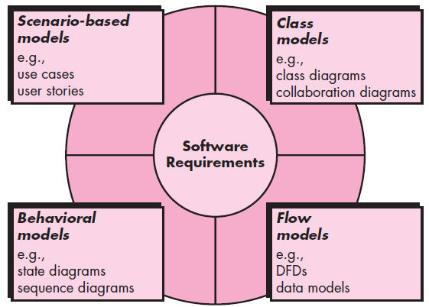
Elements of Analysis Model

Slide 4
UML Models that Supplement Use Case Model
There are many requirements modeling situations in which a text-based model—
even one as simple as a use case—may not impart information in a clear and concise manner.
In such cases, you can choose from a broad array of UML graphical models.

Slide 5
Developing an Activity Diagram
The UML activity diagram represents of the flow of interaction within a specific scenario.
Activity diagram uses rounded rectangles to imply a specific system function
Arrows to represent flow through the system

Slide 6
Developing an Activity Diagram
Decision diamonds to depict a branching decision (each arrow emanating from the diamond is labeled)
And solid horizontal lines to indicate that parallel activities are occurring.

Slide 7
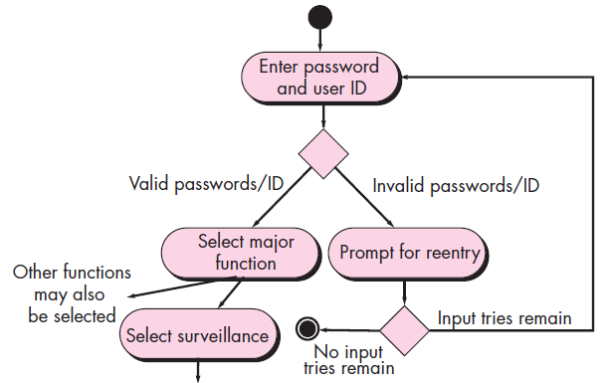
Activity Diagram

Slide 8
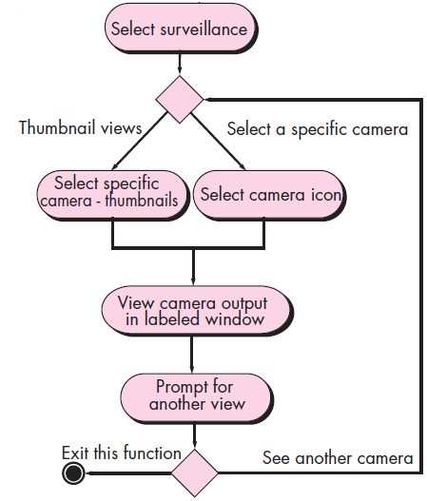
Activity Diagram

Slide 9
SwimLane Diagram
The UML swimlane diagram is a useful variation of the activity diagram and allows you to represent the flow of activities described by the use case.
At the same time indicate which actor (if there are multiple actors involved in a specific use case) or class has responsibility for the action described by an activity rectangle.

Slide 10
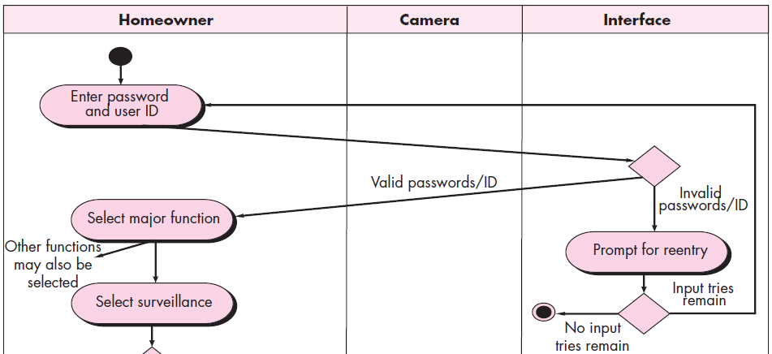
SwimLane Diagram – Camera surveillance

Slide 11
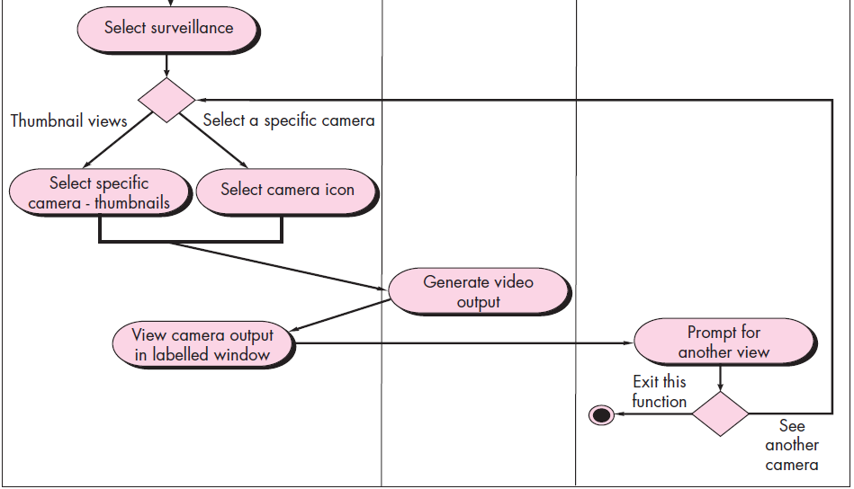
SwimLane Diagram – Camera surveillance

Slide 12
SwimLane Diagram
The activity diagram is rearranged so that activities associated with a particular class fall inside the swimlane for that class.

Slide 13
Data Model
If software requirements include the need to create, extend, or interface with a database
or if complex data structures must be constructed and manipulated,
The software team may choose to create a data model as part of overall requirements modeling.

Slide 14
Data Modeling
Database
  An organized collection of logically related data.
Data
  Stored representations of objects and events that have meaning and importance in the user’s environment.

Slide 15
Data Modeling
Information
  Data that have been processed in
  such a way as to increase the
  knowledge of the person who uses
  the data.

Slide 16
Data Modeling
Relational Database
  A database that represents data as
  a collection of tables in which all
  data relationships are represented
  by common values in related
  tables.

Slide 17
Data Modeling
Database application
  An application program (or set of
  related programs) that is used to
  perform a series of database
  activities (create, read, update, and
  delete) on behalf of database users.

Slide 18
Data Modeling
Entity
  A person, a place, an object, an
  event, or a concept in the user
  environment about which the
  organization wishes to maintain
  data.

Slide 19
Data Modeling
Attribute
A property or characteristic of an entity or relationship type that is of interest to the organization

Slide 20
Data Relationships
Relationships are the glue that holds together the various components of an E-R model.
A relationship is an association representing an interaction among the instances of one or more entity types that is of interest to the organization
Thus, a relationship has a verb phrase name

Slide 21
Data Relationships
Relationships and their characteristics (degree and cardinality) represent business rules
As well as crucial for controlling the integrity of a database

Slide 22
Data Relationships
Relationship type
A meaningful association between (or among) entity types.
The phrase meaningful association implies that the relationship allows us to answer questions that could not be answered given only the entity types

Slide 23
Data Relationships
Associative entity
An entity type that associates the instances of one or more entity types and contains attributes that are peculiar to the relationship between those entity instances

Slide 24
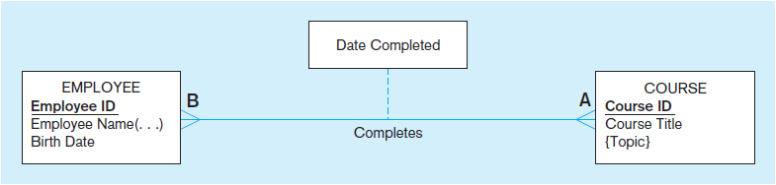
Data Relationships

Slide 25
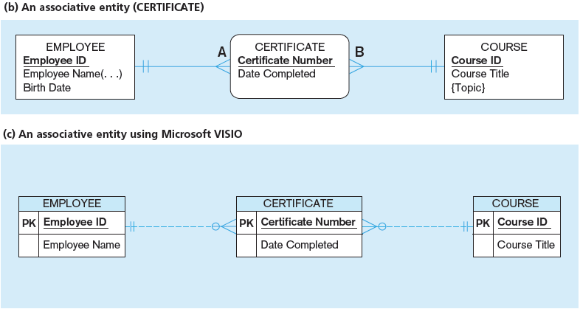
Data Relationships

Slide 26
Degree of a Relationship
Degree
  The number of entity types that participate in a relationship
Unary Relationship
  A relationship between instances of a single entity type.

Slide 27
Degree of a Relationship
Binary relationship
  A relationship between the instances of two entity types
Ternary Relationship
  A simultaneous relationship among the instances of three entity types

Slide 28
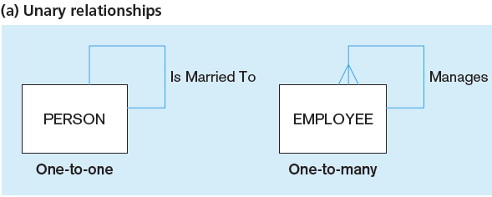
Data Relationships

Slide 29
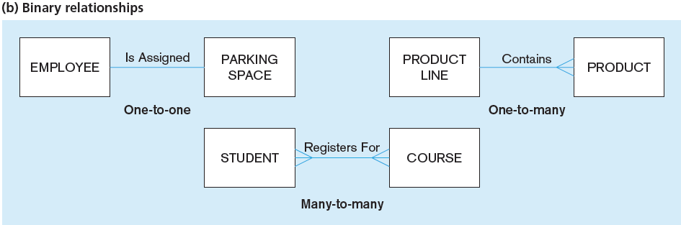
Data Relationships

Slide 30
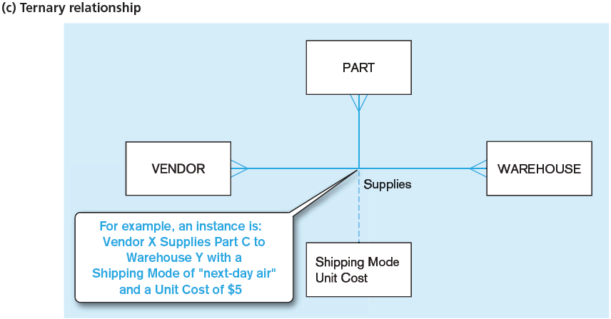
Data Relationships

Slide 31
Data Relationships
Cardinality constraint
A rule that specifies the number of instances of one entity that can (or must) be associated with each instance of another entity

Slide 32
Data Relationships
Minimum cardinality
The minimum number of instances of one entity that may be associated with each instance of another entity
Maximum cardinality
The maximum number of instances of one entity that may be associated with each instance of another entity

Slide 33
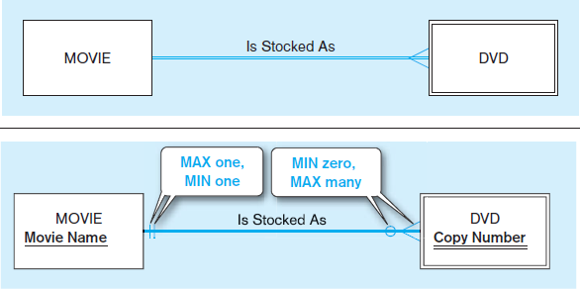
Data Relationships

Slide 34
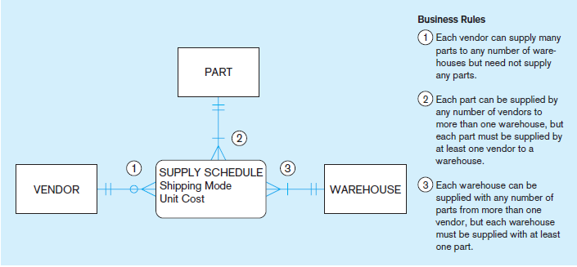
Data Relationships

Slide 35
The End
Thanks for listening
Questions would be appreciated.

